Slide 1
Správa a organizácia diskov
doc. Ing. Július BARÁTH, PhD.
Katedra Informatiky
Akadémia ozbrojených síl,
e-mail: julius.barath@aos.sk

Slide 2
Doštudovať
Vavrečková, Š.: Operační systémy – prednášky
Kapitola 8 Pamäťové médiá časť 8.5 súborové systémy pre Linux
SILBERSCHATZ, Abraham, Peter B GALVIN a Greg GAGNE. Operating system concepts. 9th ed. Hoboken, NJ: Wiley, c2013, xxii, 919 s. ISBN 978-111-8063-330.
Part Four – Storage Management

Slide 3
Overview of Mass Storage Structure
Magnetic disks provide bulk of secondary storage of modern computers
Drives rotate at 60 to 250 times per second
Transfer rate is rate at which data flow between drive and computer
Positioning time (random-access time) is time to move disk arm to desired cylinder (seek time) and time for desired sector to rotate under the disk head (rotational latency)
Head crash results from disk head making contact with the disk surface
That’s bad
Disks can be removable
Drive attached to computer via I/O bus
Busses vary, including EIDE, ATA, SATA, USB, Fibre Channel, SCSI, SAS, Firewire
Host controller in computer uses bus to talk to disk controller built into drive or storage array

Slide 4
Moving-head Disk Mechanism

Slide 5
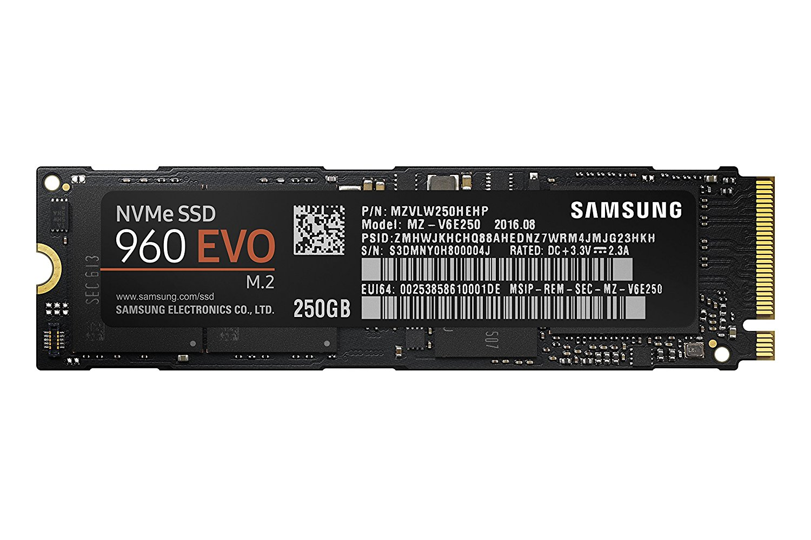
Solid-State Disks
Nonvolatile memory used like a hard drive
Many technology variations
Can be more reliable than HDDs
More expensive per MB
Maybe have shorter life span
Less capacity
But much faster
Busses can be too slow -> connect directly to PCI or M.2 for example
No moving parts, so no seek time or rotational latency

Slide 6
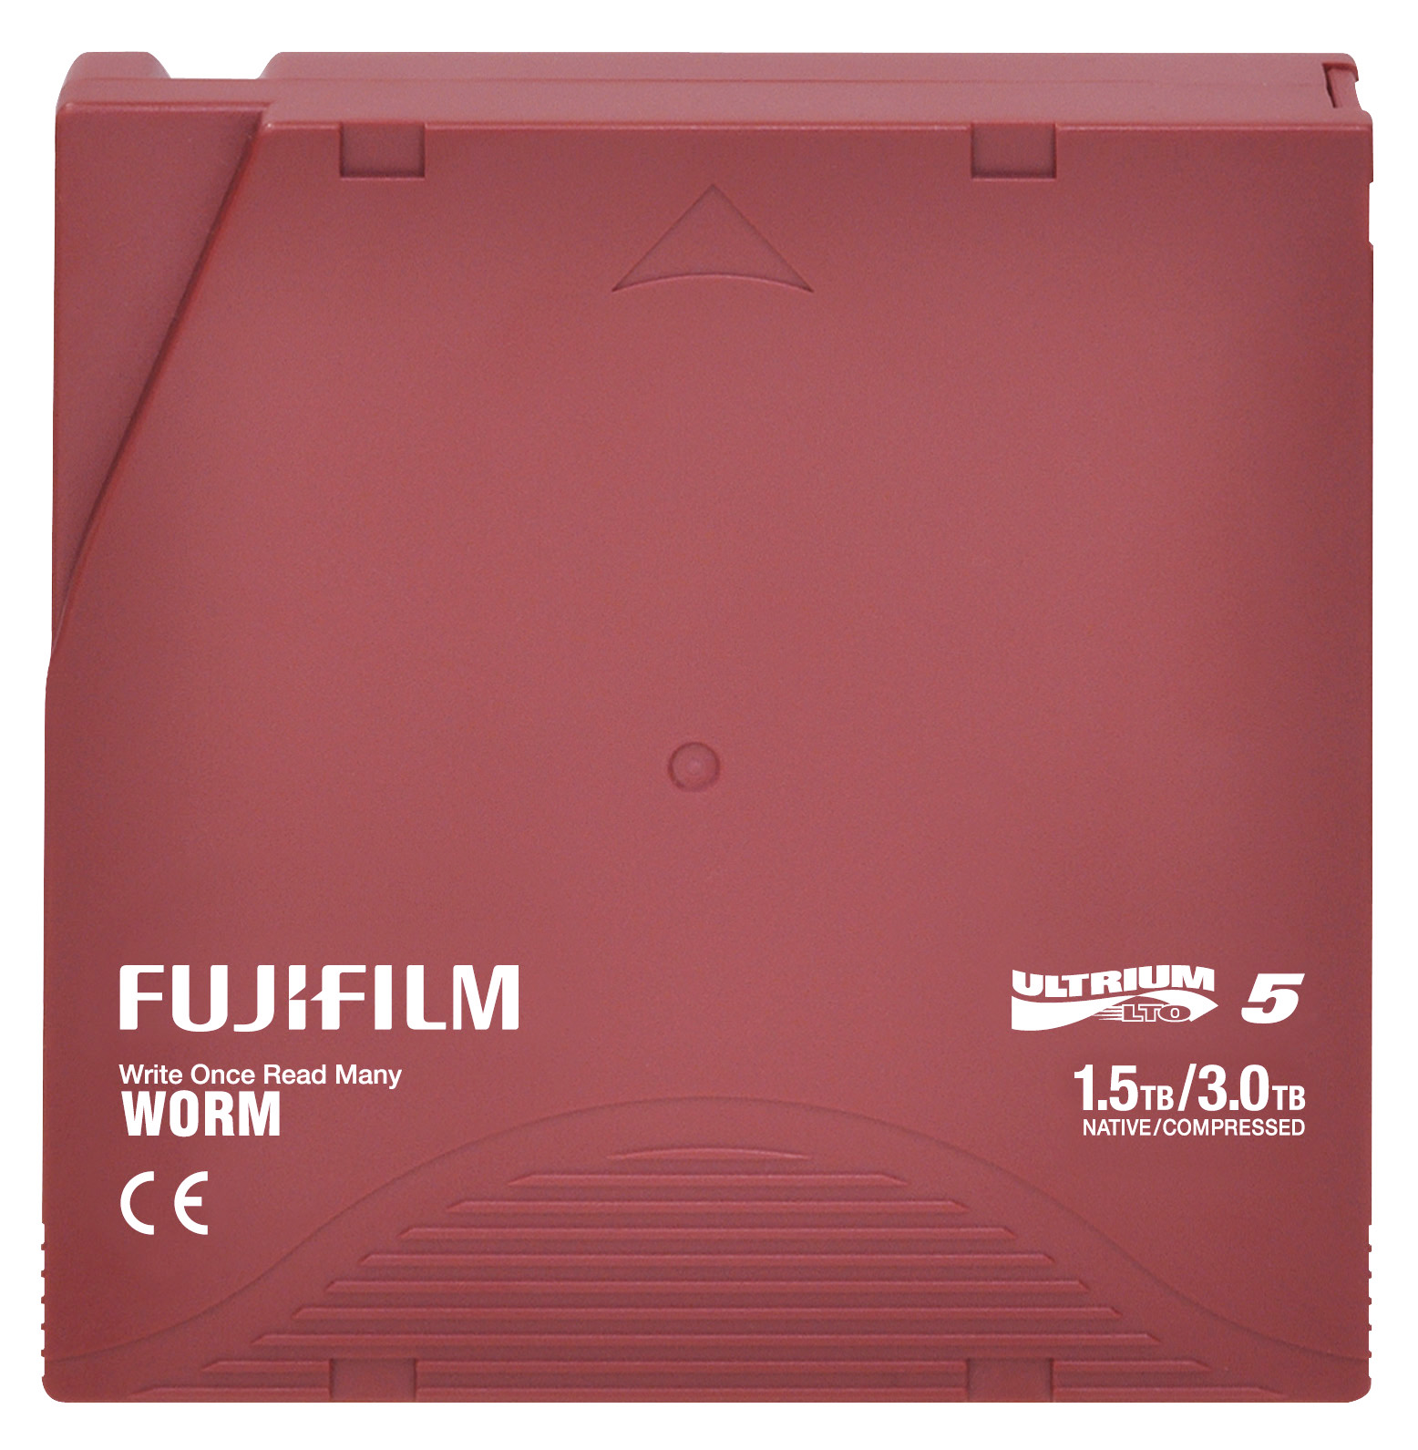
Magnetic Tape
Was early secondary-storage medium
Evolved from open spools to cartridges
Relatively permanent and holds large quantities of data
Access time slow
Random access ~1000 times slower than disk
Mainly used for archive, storage of infrequently-used data, transfer medium between systems
Kept in spool and wound or rewound past read-write head
Once data under head, transfer rates comparable to disk
140MB/sec and greater
200GB to 1.5TB typical storage
Common technologies are LTO-{3,4,5} and T10000

Slide 7
Disk Attachment
Host-attached storage accessed through I/O ports talking to I/O busses
SCSI itself is a bus, up to 16 devices on one cable, SCSI initiator requests operation and SCSI targets perform tasks
Each target can have up to 8 logical units (disks attached to device controller)
FC (fiber channel) is high-speed serial architecture
Can be switched fabric with 24-bit address space – the basis of storage area networks (SANs) in which many hosts attach to many storage units
I/O directed to bus ID, device ID, logical unit (LUN)

Slide 8
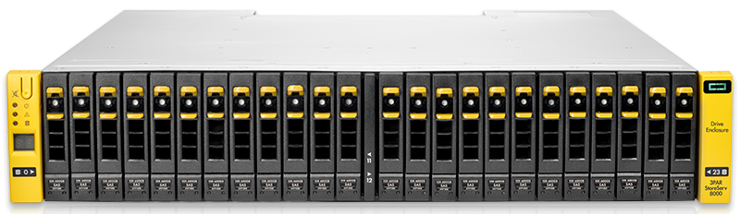
Storage Array
Can just attach disks, or arrays of disks
Storage Array has controller(s), provides features to attached host(s)
Ports to connect hosts to array
Memory, controlling software (sometimes NVRAM, etc)
A few to thousands of disks
RAID, hot spares, hot swap (discussed later)
Shared storage -> more efficiency
Features found in some file systems
Snaphots, clones, thin provisioning, replication, deduplication, etc

Slide 9
Storage Area Network
Common in large storage environments
Multiple hosts attached to multiple storage arrays - flexible

Slide 10
Storage Area Network (Cont.)
SAN is one or more storage arrays
Connected to one or more Fibre Channel switches
Hosts also attach to the switches
Storage made available via LUN Masking from specific arrays to specific servers
Easy to add or remove storage, add new host and allocate it storage
Over low-latency Fibre Channel fabric
Why have separate storage networks and communications networks?
Consider iSCSI, FCOE

Slide 11
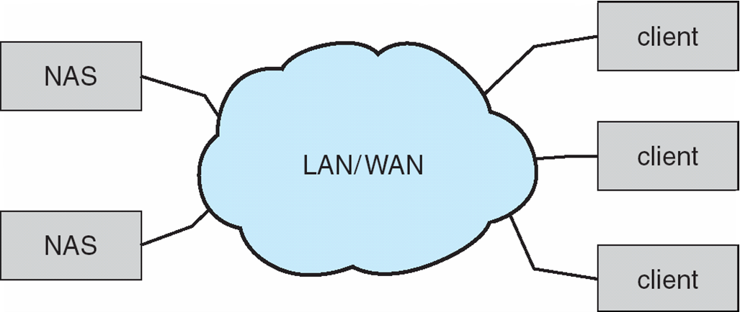
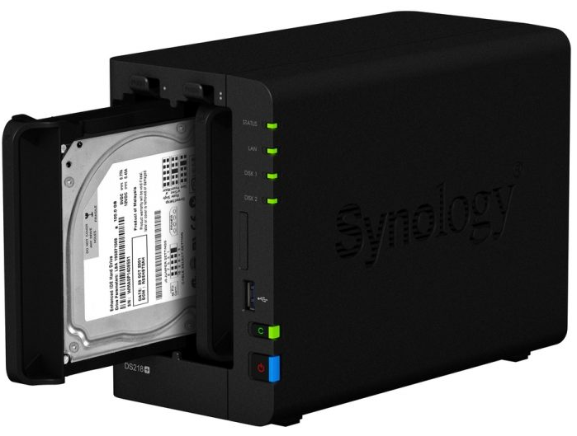
Network-Attached Storage
Network-attached storage (NAS) is storage made available over a network rather than over a local connection (such as a bus)
Remotely attaching to file systems
NFS and CIFS (Common Internet File System) are common protocols
Implemented via remote procedure calls (RPCs) between host and storage over typically TCP or UDP on IP network
iSCSI protocol uses IP network to carry the SCSI protocol
Remotely attaching to devices (blocks)

Slide 12
RAID Structure
RAID – redundant array of inexpensive disks
multiple disk drives provides reliability via redundancy
Increases the mean time to failure
Mean time to repair – exposure time when another failure could cause data loss
Mean time to data loss based on above factors
If mirrored disks fail independently, consider disk with 1300,000 mean time to failure and 10 hour mean time to repair
Mean time to data loss is 100, 000² / (2 ∗ 10) = 500 ∗ 10⁶ hours, or 57,000 years!
Frequently combined with NVRAM to improve write performance
RAID is arranged into six different levels

Slide 13
RAID (Cont.)
Several improvements in disk-use techniques involve the use of multiple disks working cooperatively
Disk striping uses a group of disks as one storage unit
RAID schemes improve performance and improve the reliability of the storage system by storing redundant data
Mirroring or shadowing (RAID 1) keeps duplicate of each disk
Striped mirrors (RAID 1+0) or mirrored stripes (RAID 0+1) provides high performance and high reliability
Block interleaved parity (RAID 4, 5, 6) uses much less redundancy
RAID within a storage array can still fail if the array fails, so automatic replication of the data between arrays is common
Frequently, a small number of hot-spare disks are left unallocated, automatically replacing a failed disk and having data rebuilt onto them

Slide 14
RAID Levels
consists of an exact copy of a set of data on two or more disks; a classic RAID 1 mirrored pair contains two disks.
RAID 2, which is rarely used in practice
RAID 3, which is rarely used in practice
RAID 4 consists of block-level striping with a dedicated parity disk
Upon failure of a single drive, subsequent reads and writes can be calculated from the distributed parity such that no data is lost.
Any form of RAID that can continue to execute read and write requests to all of a RAID array's virtual disks in the presence of any two concurrent disk failures

Slide 15
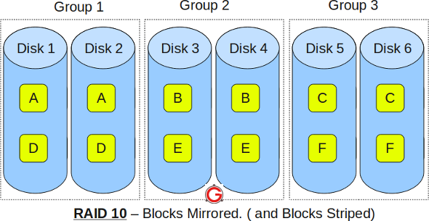
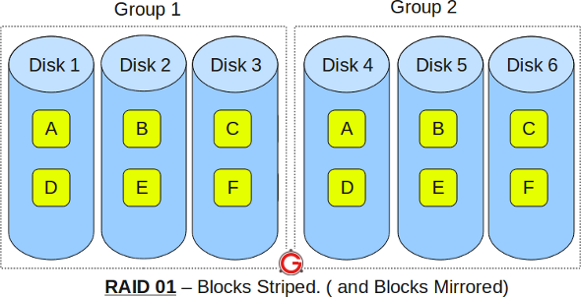
RAID (0 + 1) and (1 + 0)
Main difference between RAID 10 vs RAID 01
Performance on both RAID 10 and RAID 01 will be the same.
The storage capacity on these will be the same.
The main difference is the fault tolerance level.
So, given a choice between RAID 10 and RAID 01, always choose RAID 10.
http://www.thegeekstuff.com/2011/10/raid10-vs-raid01/
Notes:
RAID 10
RAID 10 is also called as RAID 1+0
It is also called as “stripe of mirrors”
It requires minimum of 4 disks
To understand this better, group the disks in pair of two (for mirror). For example, if you have a total of 6 disks in RAID 10, there will be three groups–Group 1, Group 2, Group 3 as shown in the above diagram.
Within the group, the data is mirrored. In the above example, Disk 1 and Disk 2 belongs to Group 1. The data on Disk 1 will be exactly same as the data on Disk 2. So, block A written on Disk 1 will be mirroed on Disk 2. Block B written on Disk 3 will be mirrored on Disk 4.
Across the group, the data is striped. i.e Block A is written to Group 1, Block B is written to Group 2, Block C is written to Group 3.
This is why it is called “stripe of mirrors”. i.e the disks within the group are mirrored. But, the groups themselves are striped.
RAID 01
RAID 01 is also called as RAID 0+1
It is also called as “mirror of stripes”
It requires minimum of 3 disks. But in most cases this will be implemented as minimum of 4 disks.
To understand this better, create two groups. For example, if you have total of 6 disks, create two groups with 3 disks each as shown below. In the above example, Group 1 has 3 disks and Group 2 has 3 disks.
Within the group, the data is striped. i.e In the Group 1 which contains three disks, the 1st block will be written to 1st disk, 2nd block to 2nd disk, and the 3rd block to 3rd disk. So, block A is written to Disk 1, block B to Disk 2, block C to Disk 3.
Across the group, the data is mirrored. i.e The Group 1 and Group 2 will look exactly the same. i.e Disk 1 is mirrored to Disk 4, Disk 2 to Disk 5, Disk 3 to Disk 6.
This is why it is called “mirror of stripes”. i.e the disks within the groups are striped. But, the groups are mirrored.
Main difference between RAID 10 vs RAID 01
Performance on both RAID 10 and RAID 01 will be the same.
The storage capacity on these will be the same.
The main difference is the fault tolerance level. On most implementations of RAID controllers, RAID 01 fault tolerance is less. On RAID 01, since we have only two groups of RAID 0, if two drives (one in each group) fails, the entire RAID 01 will fail. In the above RAID 01 diagram, if Disk 1 and Disk 4 fails, both the groups will be down. So, the whole RAID 01 will fail.
RAID 10 fault tolerance is more. On RAID 10, since there are many groups (as the individual group is only two disks), even if three disks fails (one in each group), the RAID 10 is still functional. In the above RAID 10 example, even if Disk 1, Disk 3, Disk 5 fails, the RAID 10 will still be functional.
So, given a choice between RAID 10 and RAID 01, always choose RAID 10.

Slide 16
Other Features
Regardless of where RAID implemented, other useful features can be added
Snapshot is a view of file system before a set of changes take place (i.e. at a point in time)
More in Ch 12
Replication is automatic duplication of writes between separate sites
For redundancy and disaster recovery
Can be synchronous or asynchronous
Hot spare disk is unused, automatically used by RAID production if a disk fails to replace the failed disk and rebuild the RAID set if possible
Decreases mean time to repair

Slide 17
File Concept
Contiguous logical address space
Types:
Data
numeric
character
binary
Program
Contents defined by file’s creator
Many types
Consider text file, source file, executable file

Slide 18
File Attributes
Name – only information kept in human-readable form
Identifier – unique tag (number) identifies file within file system
Type – needed for systems that support different types
Location – pointer to file location on device
Size – current file size
Protection – controls who can do reading, writing, executing
Time, date, and user identification – data for protection, security, and usage monitoring
Label – in DLP
DLP stands for Data Loss Prevention. It is a security strategy that focuses on detecting and preventing the loss, leakage, or misuse of sensitive data
Information about files are kept in the directory structure, which is maintained on the disk
Many variations, including extended file attributes such as file checksum, RO, Hidden, system, archive ...
Information kept in the directory structure

Slide 19
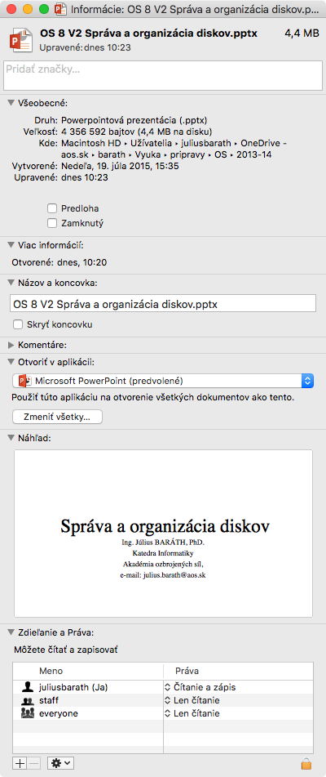
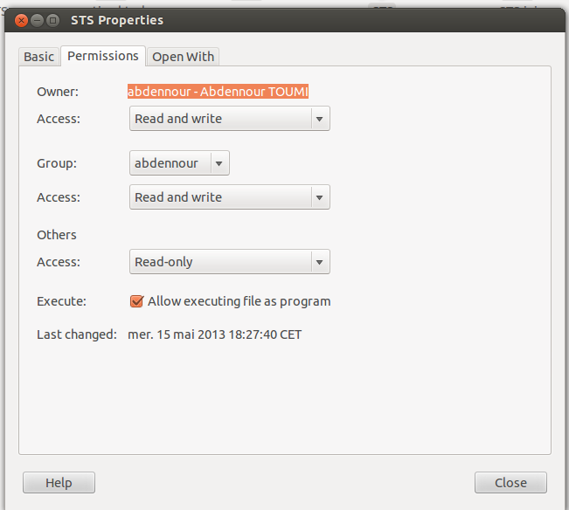
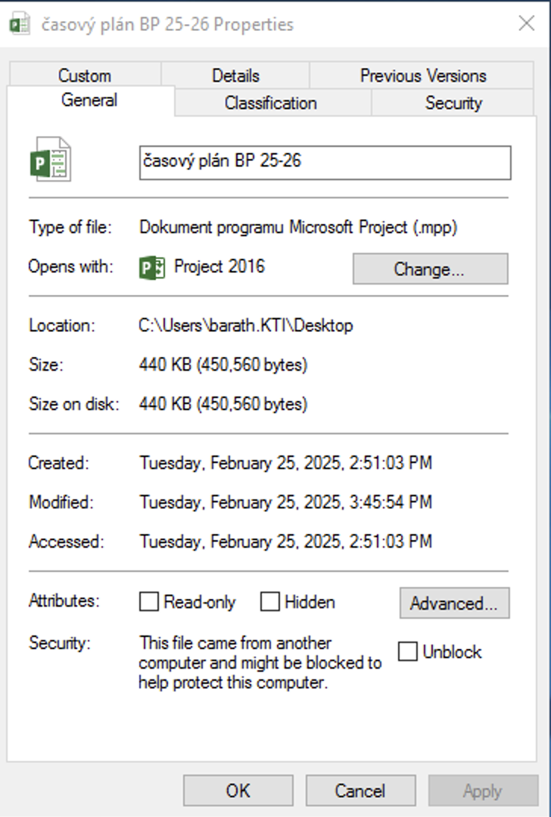
File info on different OSs

Slide 20
File Operations
File is an abstract data type
Create
Write – at write pointer location
Read – at read pointer location
Reposition within file - seek
Delete
Truncate
Open(F_{i}) – search the directory structure on disk for entry F_{i}, and move the content of entry to memory
Close (F_{i}) – move the content of entry F_{i} in memory to directory structure on disk

Slide 21
Open Files
Several pieces of data are needed to manage open files:
Open-file table: tracks open files
File pointer: pointer to last read/write location, per process that has the file open
File-open count: counter of number of times a file is open – to allow removal of data from open-file table when last processes closes it
Disk location of the file: cache of data access information
Access rights: per-process access mode information

Slide 22
Open File Locking
Provided by some operating systems and file systems
Similar to reader-writer locks
Shared lock similar to reader lock – several processes can acquire concurrently
Exclusive lock similar to writer lock
Mediates access to a file
Mandatory or advisory:
Mandatory – access is denied depending on locks held and requested
Advisory – processes can find status of locks and decide what to do

Slide 23
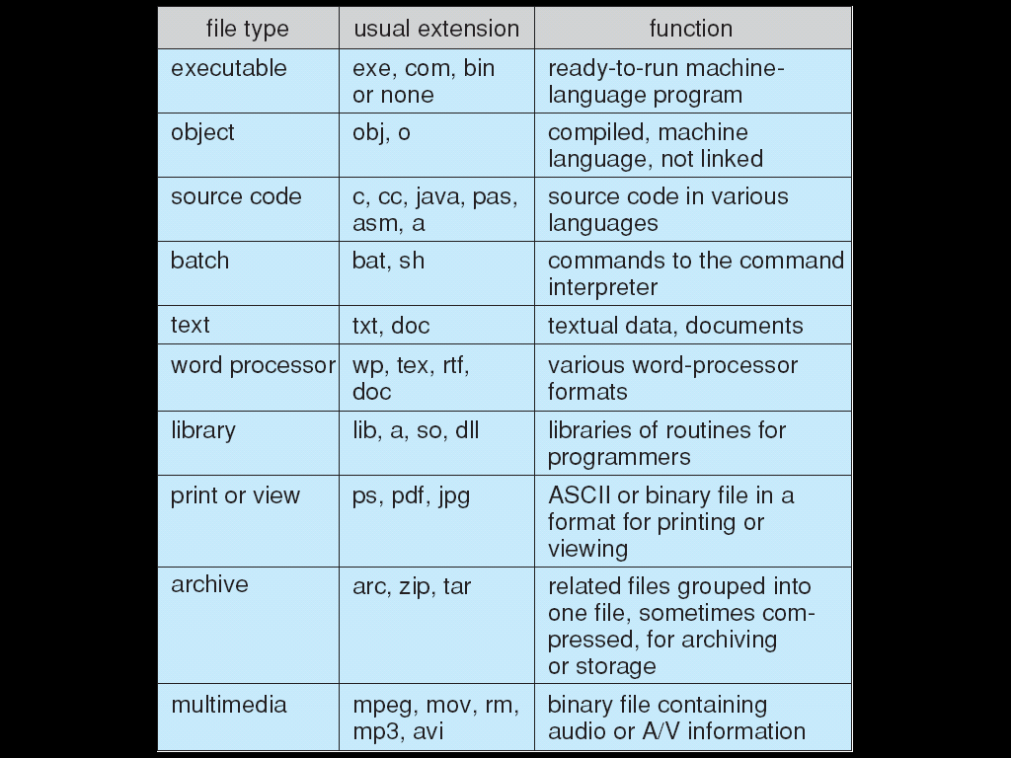
File Types – Name, Extension

Slide 24
File Structure
File structures are a way of organizing data in files. They are essential for efficient data access and manipulation. Here are some common file structures:
Sequential File Structure: Data is organized in a sequential manner, one record after the other. This is the simplest form of file structure.
Indexed File Structure: An index is created for some of the files. The index, like an index in a book, contains pointers to the various blocks. Indexing makes random access possible.
Hashed File Structure: A hash function computes the address of a record. It provides very fast access to records under certain search conditions.
B-Tree and B+ Tree File Structures: These are tree-based data structures used in databases to allow for efficient insertion, deletion, and search operations.
Heap (Unordered) File Structure: Records are placed anywhere in the file where there is space.
AVL Trees: AVL trees are self-balancing binary search trees. They are used for data in memory.
Who decides:
Operating system
Program
Zdroj:https://www.baeldung.com/cs/file-structures

Slide 25
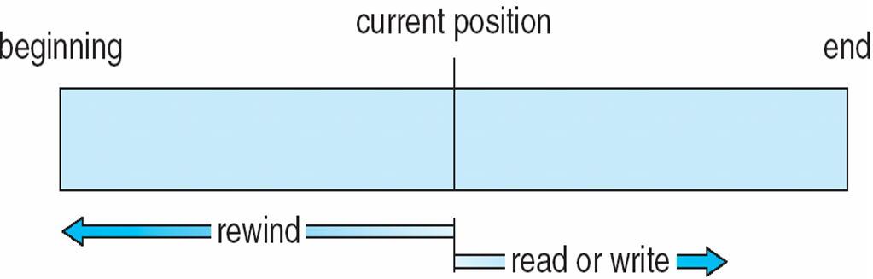
Sequential-access File

Slide 26
Access Methods
Sequential Access
read next
write next
reset
no read after last write
(rewrite)
Direct Access – file is fixed length logical records
read n
write n
position to n
read next
write next
rewrite n
n = relative block number
Relative block numbers allow OS to decide where file should be placed
See allocation problem in Ch 12

Slide 27
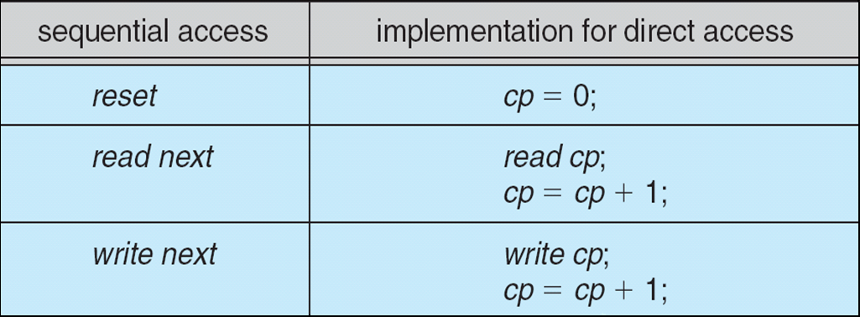
Simulation of Sequential Access on Direct-access File

Slide 28
Other Access Methods
Can be built on top of base methods
General involve creation of an index for the file
Keep index in memory for fast determination of location of data to be operated on (consider UPC code plus record of data about that item)
If too large, index (in memory) of the index (on disk)
IBM indexed sequential-access method (ISAM)
Small master index, points to disk blocks of secondary index
File kept sorted on a defined key
All done by the OS
VMS operating system provides index and relative files as another example (see next slide)

Slide 29
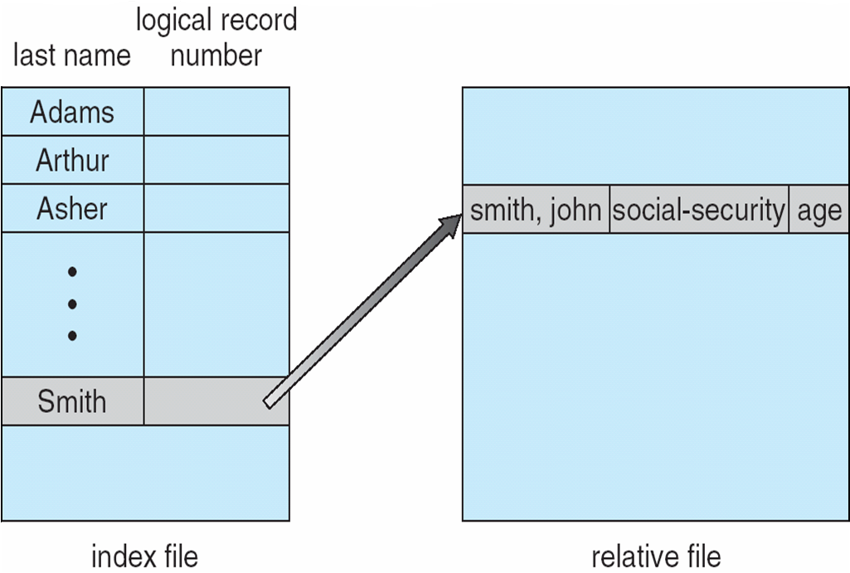
Example of Index and Relative Files

Slide 30
Directory Structure
A collection of nodes containing information about all files
Directory
Files
F 1
F 2
F 3
F 4
F n
Both the directory structure and the files reside on disk

Slide 31
Disk Structure
Disk can be subdivided into partitions
Disks or partitions can be RAID protected against failure
Disk or partition can be used raw – without a file system, or formatted with a file system
Partitions also known as minidisks, slices
Entity containing file system known as a volume
Each volume containing file system also tracks that file system’s info in device directory or volume table of contents
As well as general-purpose file systems there are many special-purpose file systems, frequently all within the same operating system or computer

Slide 32
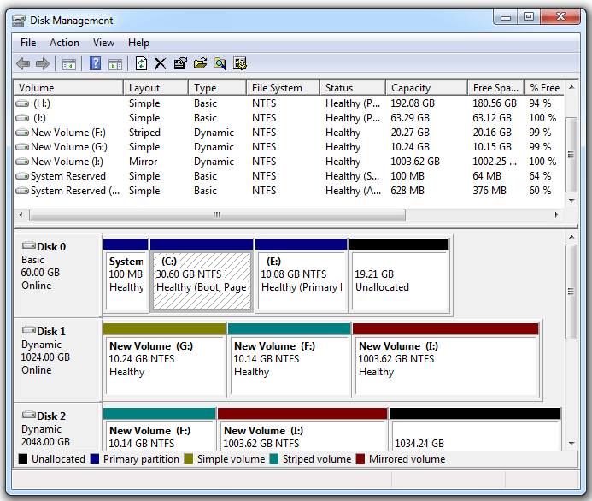
A Typical File-system Organization
F: striped 10,14+10,14=20,28GB
G: simple 10,24GB
I: Mirror 2x1003,62=1003,62GB
https://www.minitool.com/partition-disk/volume-vs-partition.html

Slide 33
Partition vs Volume
A partition and a volume are both units of data storage, but they are used in different contexts and have different properties:
Partition: A partition is a logical division of a hard disk. It’s a portion of a disk with a specific size. Partitions are created on a basic disk. There are three partition types: primary partition, logical partition, and extended partition.
Volume: A volume is a single accessible storage area with a single file system. Volumes are created on a dynamic disk. There are five volume types: simple volume, mirrored volume, striped volume, spanned volume, and RAID-5 volume.
Partition je oddelená časť pevného disku, ktorá je formátovaná a má pridelený súborový systém.
Volume je logická jednotka úložiska, ktorá môže byť vytvorená na jednej alebo viacerých partíciách a reprezentuje priestor, ktorý je dostupný pre ukladanie dát.
Jednoducho povedané, partícia je ako rozdelenie fyzického disku na menšie časti, zatiaľ čo volume je to, čo vidíte v operačnom systéme ako “disk C:” alebo “disk D:”, kde môžete ukladať súbory.

Slide 34
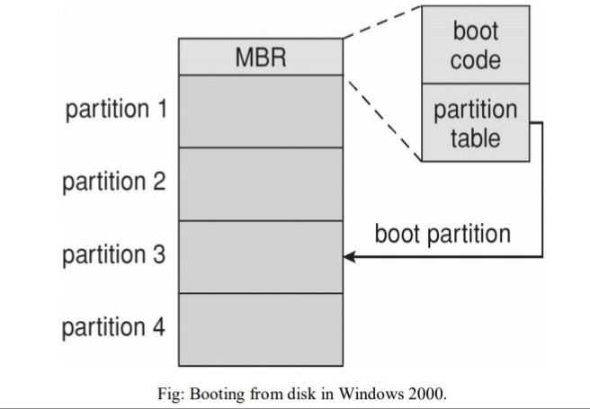
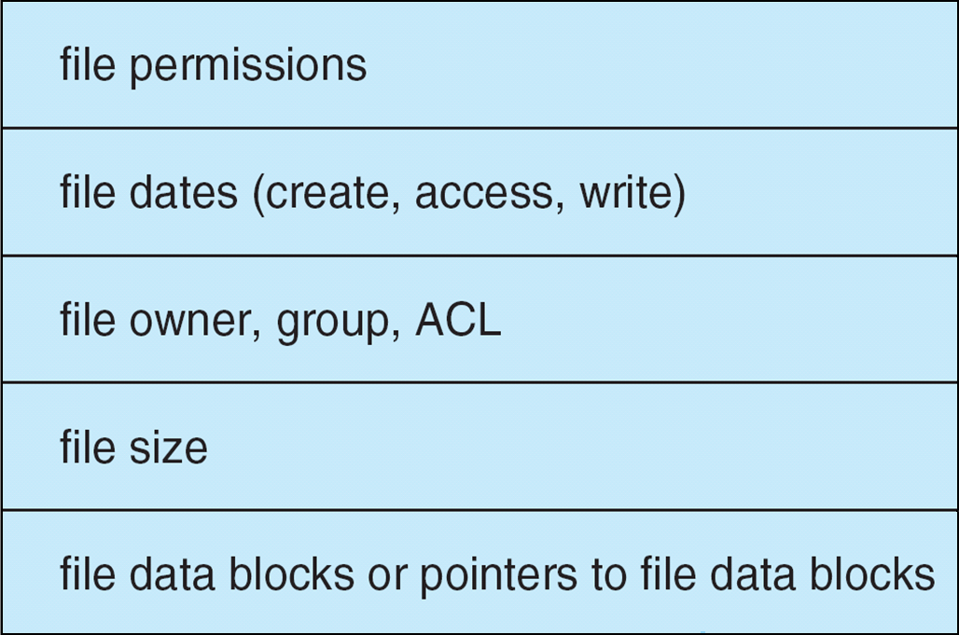
File-System Implementation
We have system calls at the API level, but how do we implement their functions?
On-disk and in-memory structures
Boot control block (Master Boot Record) contains info needed by system to boot OS from that volume
Needed if volume contains OS, usually first block of volume
Location Cylinder 0, Head 0, Sector 1.
Volume control block (superblock, master file table) contains volume details
Total # of blocks, # of free blocks, block size, free block pointers or array
Directory structure organizes the files
Names and inode numbers, master file table
Per-file File Control Block (FCB) contains many details about the file
inode number, permissions, size, dates
NTFS stores master file table using relational DB structures in s a special file named $MFT

Slide 35
Partitions and Mounting
Partition can be a volume containing a file system (“cooked”) or raw – just a sequence of blocks with no file system
Boot block can point to boot volume or boot loader set of blocks that contain enough code to know how to load the kernel from the file system
Or a boot management program for multi-os booting
Root partition contains the OS, other partitions can hold other OSes, other file systems, or be raw
Mounted at boot time
Other partitions can mount automatically or manually
At mount time, file system consistency checked
Is all metadata correct?
If not, fix it, try again
If yes, add to mount table, allow access

Slide 36
Types of File Systems
We mostly talk of general-purpose file systems
But systems frequently have may file systems, some general- and some special- purpose
Consider UNIX has
ext (Extended File System): This is the first file system created specifically for Linux. It has evolved through multiple versions - ext2, ext3, and ext4
tmpfs – memory-based volatile FS for fast, temporary I/O
procfs – kernel interface to process structures
objfs – interface into kernel memory to get kernel symbols for debugging
ctfs – contract file system for managing daemons
lofs – loopback file system allows one FS to be accessed in place of another
ufs, zfs – general purpose file systems
Windows has NTFS, FAT, ExFAT (modern replacement for FAT32 ),ReFS, UDF
MacOS has Mac OS Extended, APFS, Mac OS Extended (known as HFS+),FAT, ExFAT
ISO9660 (CDFS) and Joliet are widely used for CD's and UDF is widely used for DVD's

Slide 37
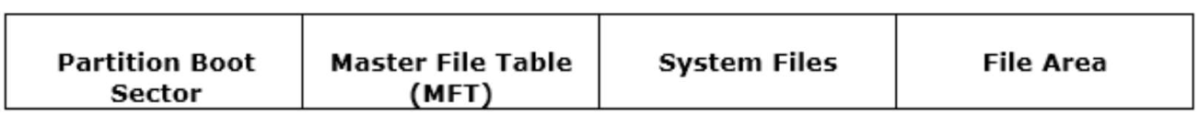
How NTFS works
When a HD is being formated, it gets divided into partiions of the total space of the hard disk. The OS keeps track of all the files that are strored in each partition of the HD. In actual each file is stored in single or multiple clusters on HD. NTFS file system the size of the these clusters varies from 512 Bytes to 64KB.
When a volume is formatted with NTFS, serveral file systems are created as result of this. Some of them include $LogFile and $Bitmap.
When OS creates a file using NTFS, the record about thata file is stored in the file known as Master File Table of MTF.
NTFS File System Forensic Analysis – Forensics of NTFS (xploreforensics.com)

Slide 38
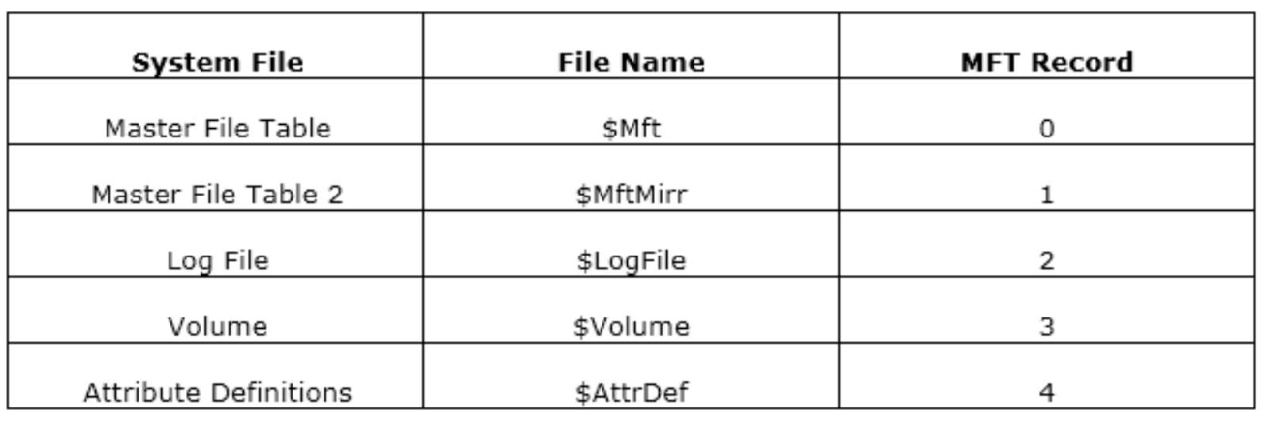
File systems of NTFS
There are several system files, which are stored in the NTFS but are hidden from the NTFS view. These files are used by the system for storing the data and for implementing the file system.
Each system file is stored with a different file name and on a different MFT Record on the NTFS volume.

Slide 39
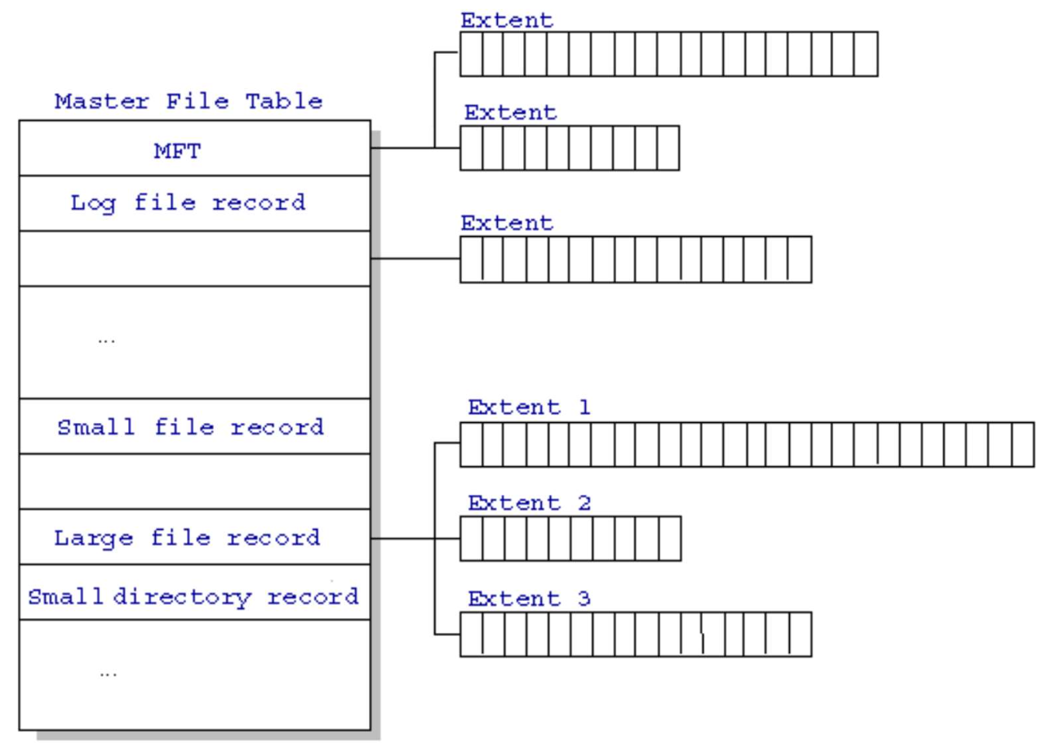
Structure of MFT
NTFS has reserved the first 16 records of the table for storing the special information. The first record describes the MFT, which is followed by the MFT mirror record. This mirror record tends to be useful in case the MTF record is corrupted. NTFS reads this mirror copy ta such instance. The location of both the MFT and MFT mirror copy gets recorded in the boot sector.

Slide 40
Structure of MFT
All information about a file, including its size, time and date stamps, permissions, and data content, is stored either in MFT entries, or in space outside the MFT that is described by MFT entries.
As files are added to an NTFS file system volume, more entries are added to the MFT and the MFT increases in size. When files are deleted from an NTFS file system volume, their MFT entries are marked as free and may be reused. However, disk space that has been allocated for these entries is not reallocated, and the size of the MFT does not decrease.
The NTFS file system reserves space for the MFT to keep the MFT as contiguous as possible as it grows.
https://learn.microsoft.com/en-us/windows/win32/fileio/master-file-table

Slide 41
Operations Performed on Directory
Search for a file
Create a file
Delete a file
List a directory
Rename a file
Traverse the file system

Slide 42
Organize the Directory (Logically) to Obtain
Efficiency – locating a file quickly
Naming – convenient to users
Two users can have same name for different files
The same file can have several different names
Grouping – logical grouping of files by properties, (e.g., all Java programs, all games, …)

Slide 43
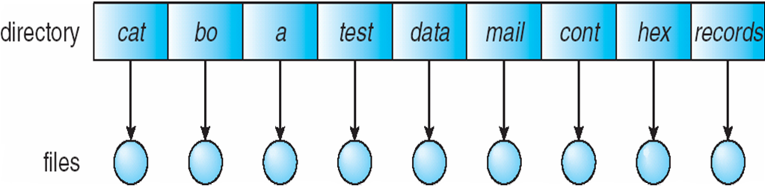
Single-Level Directory
A single directory for all users
Naming problem
Grouping problem

Slide 44
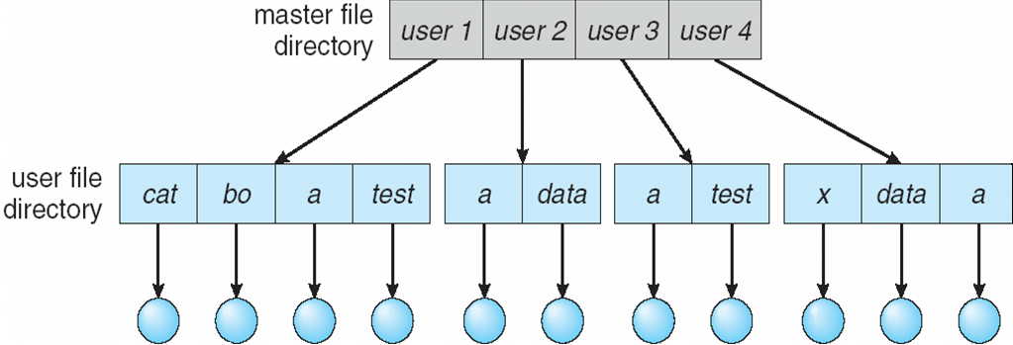
Two-Level Directory
Separate directory for each user
Path name
Can have the same file name for different user
Efficient searching
No grouping capability

Slide 45
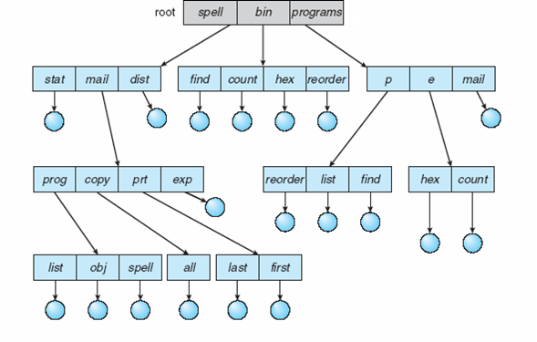
Tree-Structured Directories
Efficient searching
Grouping Capability Current directory (working directory)
cd /spell/mail/prog
type list

Slide 46
Tree-Structured Directories (Cont)
Absolute or relative path name
Creating a new file is done in current directory
Delete a file
rm <file-name>
Creating a new subdirectory is done in current directory
mkdir <dir-name>
Example: if in current directory /mail
mkdir count
mail
prog
copy
prt
exp
count
Deleting “mail” ⇒ deleting the entire subtree rooted by “mail”

Slide 47
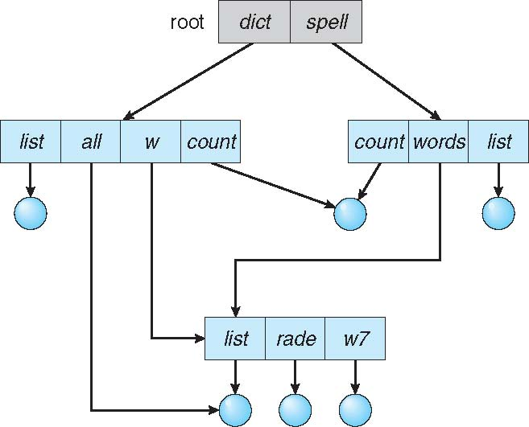
Acyclic-Graph Directories
Have shared subdirectories and files

Slide 48
Acyclic-Graph Directories (Cont.)
Two different names (aliasing)
If dict deletes list ⇒ dangling pointer (“visiaci ukazovateľ)
Solutions:
Backpointers, so we can delete all pointers Variable size records a problem
Backpointers using a daisy chain organization
Entry-hold-count solution
New directory entry type
Link – another name (pointer) to an existing file
Resolve the link – follow pointer to locate the file

Slide 49
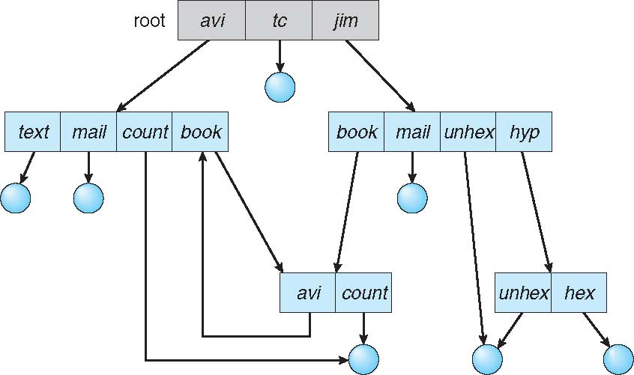
General Graph Directory
How do we guarantee no cycles?
Allow only links to file not subdirectories
Garbage collection
Every time a new link is added use a cycle detection algorithm to determine whether it is OK

Slide 50

Zdroj: https://youtu.be/YslfY4W-NAg?si=SlEEKMHYX0EyFIAz a https://www.ugent.be/en/research/datamanagement
a https://libraries.mit.edu/data-management/store/organize/

Slide 51


Slide 52


Slide 53


Slide 54
File System Mounting
A file system must be mounted before it can be accessed
A unmounted file system (i.e., Fig. (b)) is mounted at a mount point

Slide 55
File Sharing
Sharing of files on multi-user systems is desirable
Sharing may be done through a protection scheme
On distributed systems, files may be shared across a network
Network File System (NFS) is a common distributed file-sharing method
If multi-user system
User IDs identify users, allowing permissions and protections to be per-user Group IDs allow users to be in groups, permitting group access rights
Owner of a file / directory
Group of a file / directory

Slide 56
File Sharing – Remote File Systems
Uses networking to allow file system access between systems
Manually via programs like FTP
Automatically, seamlessly using distributed file systems
Semi automatically via the world wide web
Client-server model allows clients to mount remote file systems from servers
Server can serve multiple clients
Client and user-on-client identification is insecure or complicated
NFS is standard UNIX client-server file sharing protocol
CIFS (Common Internet File System) is standard Windows protocol
Standard operating system file calls are translated into remote calls
Distributed Information Systems (distributed naming services) such as LDAP, DNS, NIS, Active Directory implement unified access to information needed for remote computing

Slide 57
File Sharing – Failure Modes
All file systems have failure modes
For example corruption of directory structures or other non-user data, called metadata
Remote file systems add new failure modes, due to network failure, server failure
Recovery from failure can involve state information about status of each remote request
Stateless protocols such as NFS v3 include all information in each request, allowing easy recovery but less security

Slide 58
File Sharing – Consistency Semantics
Specify how multiple users are to access a shared file simultaneously
Similar to Ch 5 process synchronization algorithms
Tend to be less complex due to disk I/O and network latency (for remote file systems
Andrew File System (AFS) implemented complex remote file sharing semantics
Unix file system (UFS) implements:
Writes to an open file visible immediately to other users of the same open file
Sharing file pointer to allow multiple users to read and write concurrently
AFS has session semantics
Writes only visible to sessions starting after the file is closed

Slide 59
Protection
File owner/creator should be able to control:
what can be done
by whom
Types of access
Read
Write
Execute
Append
Delete
List

Slide 60
Access Lists and Groups
Mode of access: read, write, execute
Three classes of users on Unix / Linux
RWX
a) owner access 7 ⇒ 1 1 1 RWX
b) group access 6 ⇒ 1 1 0
RWX
c) public access 1 ⇒ 0 0 1
Ask manager to create a group (unique name), say G, and add some users to the group.
For a particular file (say game) or subdirectory, define an appropriate access.
owner
group
public
chmod
761
game
Attach a group to a file chgrp G game

Slide 61
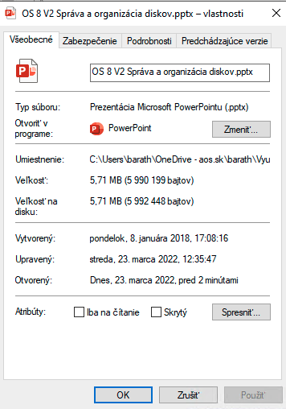
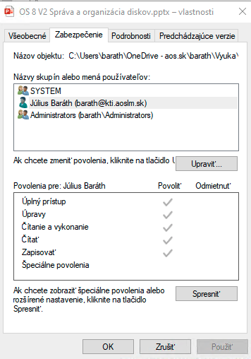
Windows 10 Access-Control List Management

Slide 62
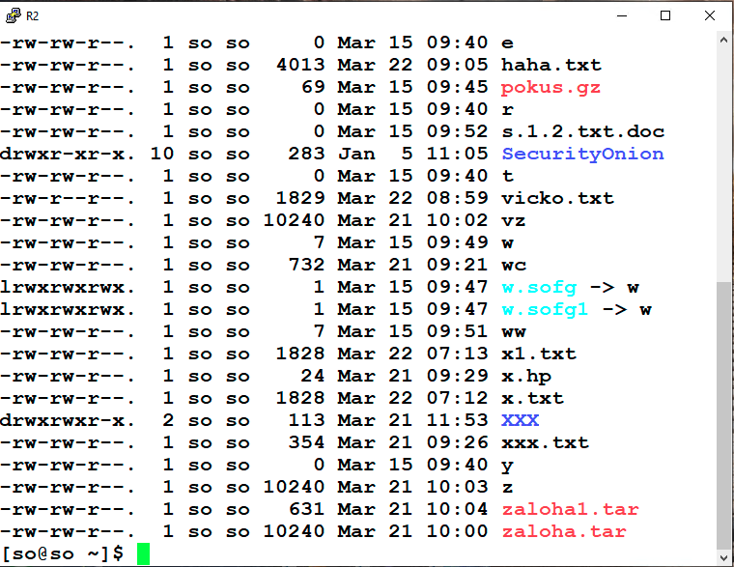
A Sample UNIX Directory Listing

Slide 63
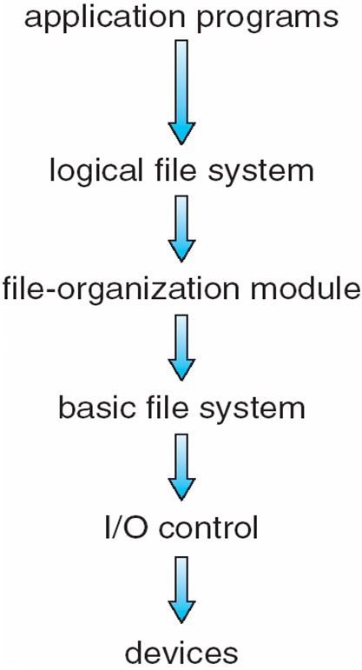
File-System Structure
File structure
Logical storage unit
Collection of related information
File system resides on secondary storage (disks)
Provided user interface to storage, mapping logical to physical
Provides efficient and convenient access to disk by allowing data to be stored, located retrieved easily
Disk provides in-place rewrite and random access
I/O transfers performed in blocks of sectors (usually 512 bytes)
File control block – storage structure consisting of information about a file
Device driver controls the physical device
File system organized into layers

Slide 64
File System Layers
Device drivers manage I/O devices at the I/O control layer
Given commands like “read drive1, cylinder 72, track 2, sector 10, into memory location 1060” outputs low-level hardware specific commands to hardware controller
Basic file system given command like “retrieve block 123” translates to device driver
Also manages memory buffers and caches (allocation, freeing, replacement)
Buffers hold data in transit
Caches hold frequently used data
File organization module understands files, logical address, and physical blocks
Translates logical block # to physical block #
Manages free space, disk allocation

Slide 65
File System Layers (Cont.)
Logical file system manages metadata information
Translates file name into file number, file handle, location by maintaining file control blocks (inodes in Unix)
Directory management
Protection
Layering useful for reducing complexity and redundancy, but adds overhead and can decrease performance
Logical layers can be implemented by any coding method according to OS designer
Many file systems, sometimes many within an operating system
Each with its own format (CD-ROM is ISO 9660; Unix has UFS, FFS; Windows has FAT, FAT32, NTFS as well as floppy, CD, DVD Blu-ray, Linux has more than 40 types, with extended file system ext2, ext3 and ext4 leading; plus distributed file systems, etc)
New ones still arriving – ZFS, GoogleFS, Oracle ASM, FUSE https://en.wikipedia.org/wiki/Comparison_of_file_systems

Slide 66
In-Memory File System Structures
Mount table storing file system mounts, mount points, file system types
Plus buffers hold data blocks from secondary storage
Open returns a file handle for subsequent use
Data from read eventually copied to specified user process memory address

Slide 67
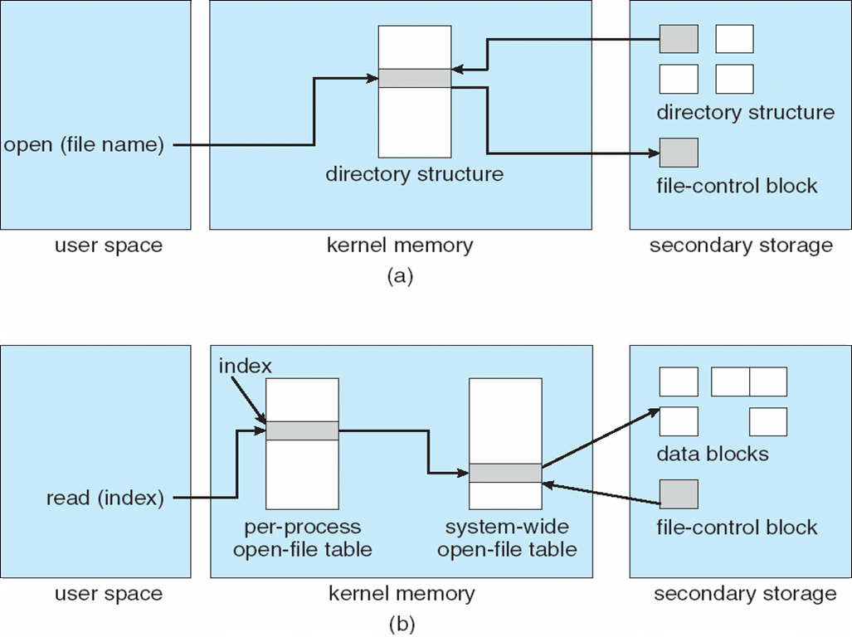
In-Memory File System Structures
The following figure illustrates the necessary file system structures provided by the operating systems
Figure 12-3(a) refers to opening a file
Figure 12-3(b) refers to reading a file

Slide 68
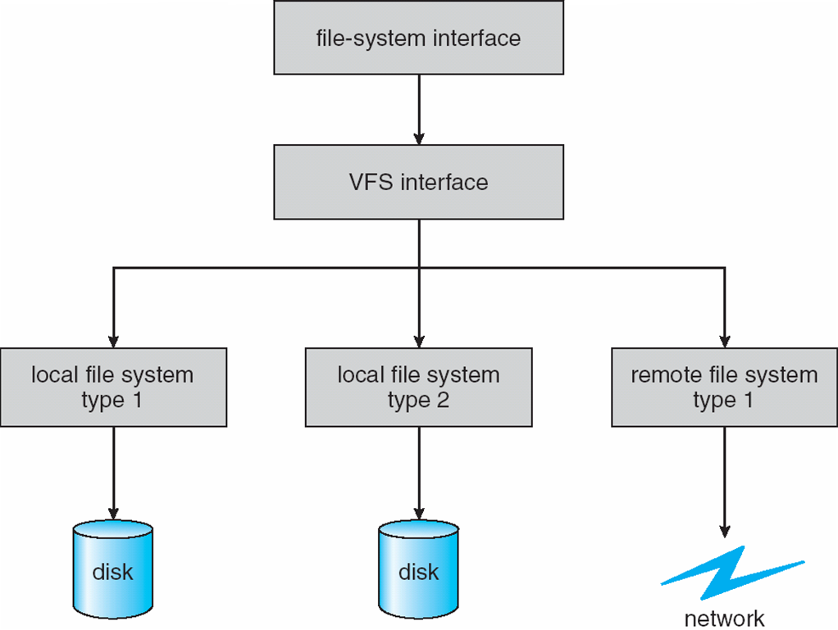
Virtual File Systems
A Virtual File System (VFS), also known as a Virtual Filesystem Switch, is an abstract layer on top of a more concrete file system.
The purpose of a VFS is to allow client applications to access different types of concrete file systems in a uniform way. It provides a consistent interface to multiple file systems, both local and remote.
This consistent interface allows the user to view the directory tree on the running system as a single entity even when the tree is made up of a number of diverse file system types.
The API is to the VFS interface, rather than any specific type of file system

Slide 69
Virtual File System Implementation
For example, Linux has four object types:
inode, file, superblock, dentry
VFS defines set of operations on the objects that must be implemented
Every object has a pointer to a function table
Function table has addresses of routines to implement that function on that object
For example:
• int open(. . .)—Open a file
• int close(. . .)—Close an already-open file
• ssize t read(. . .)—Read from a file
• ssize t write(. . .)—Write to a file
• int mmap(. . .)—Memory-map a file

Slide 70
Directory Implementation
Linear list of file names with pointer to the data blocks
Simple to program
Time-consuming to execute
Linear search time
Could keep ordered alphabetically via linked list or use B+ tree
Hash Table – linear list with hash data structure
Decreases directory search time
Collisions – situations where two file names hash to the same location
Only good if entries are fixed size, or use chained-overflow method

Slide 71
Allocation Methods
An allocation method refers to how disk blocks are allocated for files:
Contiguous allocation
Linked allocation
Indexed allocation
Contiguous allocation – each file occupies set of contiguous blocks
Best performance in most cases
Simple – only starting location (block #) and length (number of blocks) are required
Problems include finding space for file, knowing file size, external fragmentation, need for compaction off-line (downtime) or on-line

Slide 72
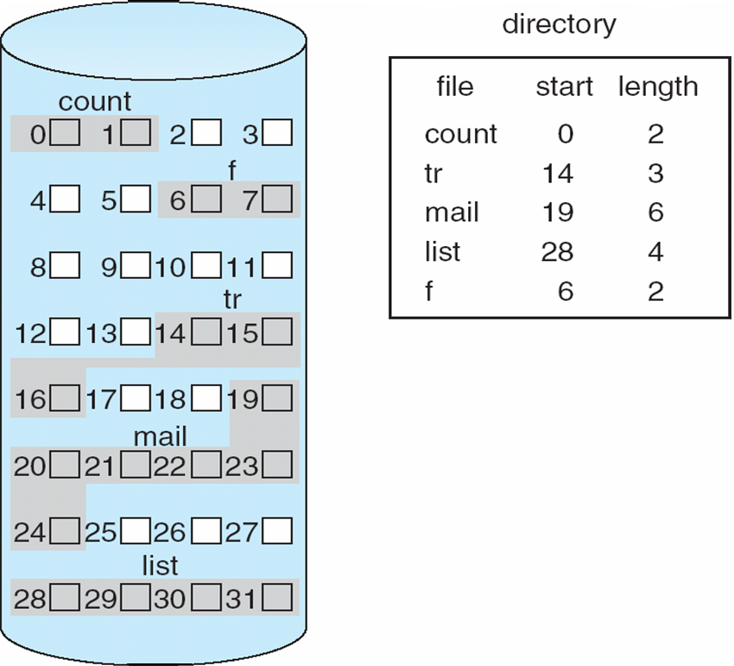
Contiguous Allocation
Mapping from logical to physical
Q
LA/512
R
Block to be accessed = Q + starting address
Displacement into block = R

Slide 73
Extent-Based Systems
Many newer file systems (i.e., Veritas File System) use a modified contiguous allocation scheme
Extent-based file systems allocate disk blocks in extents
An extent is a contiguous block of disks
Extents are allocated for file allocation
A file consists of one or more extents

Slide 74
Allocation Methods - Linked
Linked allocation – each file a linked list of blocks
File ends at nil pointer
No external fragmentation
Each block contains pointer to next block
No compaction, external fragmentation
Free space management system called when new block needed
Improve efficiency by clustering blocks into groups but increases internal fragmentation
Reliability can be a problem
Locating a block can take many I/Os and disk seeks
FAT (File Allocation Table) variation
Beginning of volume has table, indexed by block number
Much like a linked list, but faster on disk and cacheable
New block allocation simple

Slide 75
Linked Allocation
Each file is a linked list of disk blocks: blocks may be scattered anywhere on the disk
block =
pointer

Slide 76
Linked Allocation
Mapping
Q
LA/511
R
Block to be accessed is the Qth block in the linked chain of blocks representing the file.
Displacement into block = R + 1

Slide 77
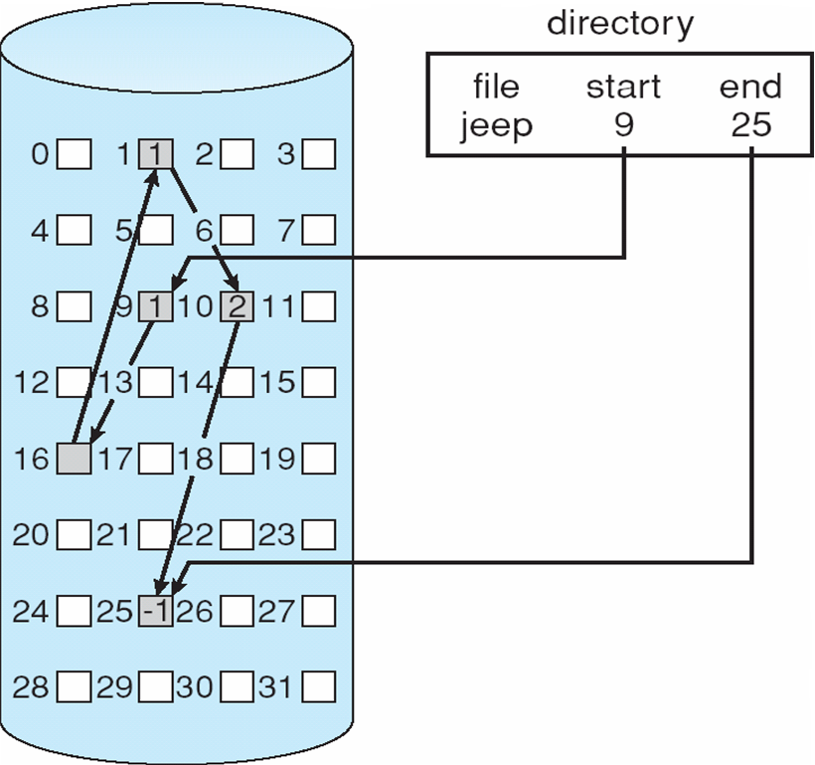
Linked Allocation
10
16
25
1

Slide 78
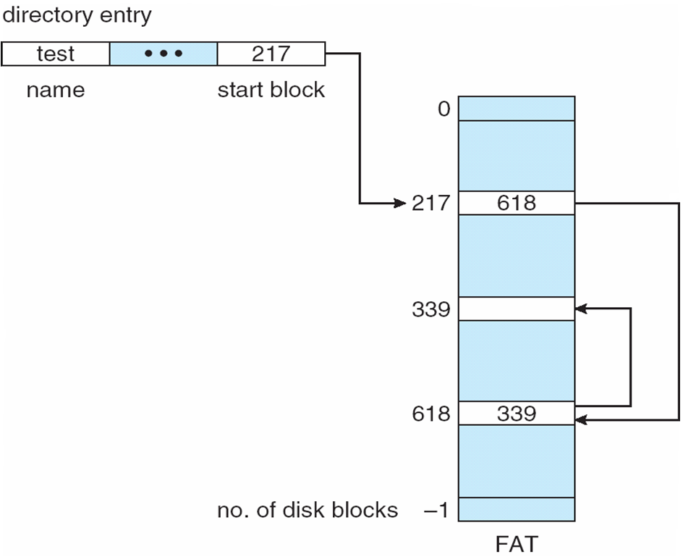
File-Allocation Table

Slide 79
Allocation Methods - Indexed
Indexed allocation
Each file has its own index block(s) of pointers to its data blocks
Logical view
index table

Slide 80
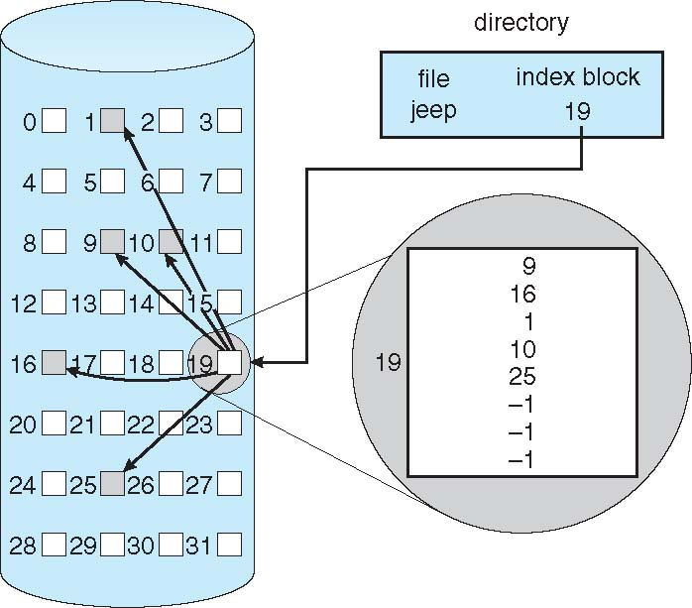
Example of Indexed Allocation

Slide 81
Indexed Allocation (Cont.)
Need index table
Random access
Dynamic access without external fragmentation, but have overhead of index block
Mapping from logical to physical in a file of maximum size of 256K bytes and block size of 512 bytes. We need only 1 block for index table
Q
LA/512
R
Q = displacement into index table
R = displacement into block

Slide 82
Indexed Allocation – Mapping (Cont.)
Mapping from logical to physical in a file of unbounded length (block size of 512 words)
Linked scheme – Link blocks of index table (no limit on size)
Q₁
LA / (512 x 511)
R₁
Q₁ = block of index table
R₁ is used as follows:
Q₂
R₁ / 512
R₂
Q₂ = displacement into block of index table
R₂ displacement into block of file:

Slide 83
Indexed Allocation – Mapping (Cont.)
Two-level index (4K blocks could store 1,024 four-byte pointers in outer index -> 1,048,567 data blocks and file size of up to 4GB)
Q₁
LA / (512 x 512)
R₁
Q₁ = displacement into outer-index
R₁ is used as follows:
Q₂
R₁ / 512
R₂
Q₂ = displacement into block of index table
R₂ displacement into block of file:

Slide 84
Indexed Allocation – Mapping (Cont.)

outer-index
index table
file

Slide 85
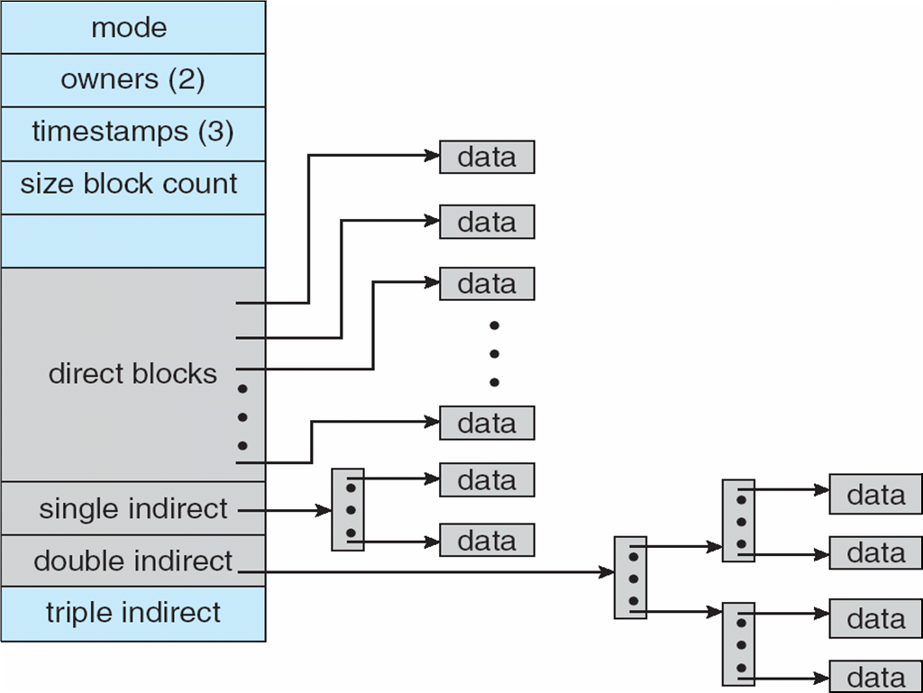
Combined Scheme: UNIX UFS (sometimes referred to as the Berkeley Fast File System) (4K bytes per block, 32-bit addresses)
Note: More index blocks than can be addressed with 32-bit file pointer

Slide 86
Performance
Best method depends on file access type
Contiguous great for sequential and random
Linked good for sequential, not random
Declare access type at creation -> select either contiguous or linked
Indexed more complex
Single block access could require 2 index block reads then data block read
Clustering can help improve throughput, reduce CPU overhead

Slide 87
Performance (Cont.)
Adding instructions to the execution path to save one disk I/O is reasonable
Intel Core i7 Extreme Edition 990x (2011) at 3.46Ghz = 159,000 MIPS
http://en.wikipedia.org/wiki/Instructions_per_second
Typical disk drive at 250 I/Os per second
159,000 MIPS / 250 = 630 million instructions during one disk I/O
Fast SSD drives provide 60,000 IOPS
159,000 MIPS / 60,000 = 2.65 millions instructions during one disk I/O

Slide 88
Free-Space Management
File system maintains free-space list to track available blocks/clusters
(Using term “block” for simplicity)
Bit vector or bit map (n blocks)
0
1
2
n-1
…
1 ⇒ block[i] free
0 ⇒ block[i] occupied

bit[i] =
Block number calculation
(number of bits per word) *
(number of 0-value words) +
offset of first 1 bit
CPUs have instructions to return offset within word of first “1” bit

Slide 89
Free-Space Management (Cont.)
Bit map requires extra space
Example:
block size = 4KB = 2¹² bytes
disk size = 2⁴⁰ bytes (1 terabyte)
n = 2⁴⁰/2¹² = 2²⁸ bits (or 32MB)
if clusters of 4 blocks -> 8MB of memory
Easy to get contiguous files

Slide 90
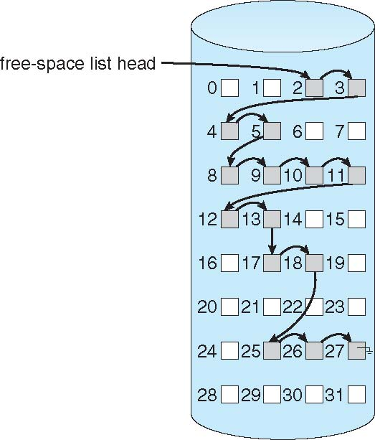
Linked Free Space List on Disk
Linked list (free list)
Cannot get contiguous space easily
No waste of space
No need to traverse the entire list (if # free blocks recorded)

Slide 91
Doštudovať
Vavrečková, Š.: Operační systémy – prednášky
Kapitola 8 Pamäťové médiá časť 8.5 súborové systémy pre Linux
SILBERSCHATZ, Abraham, Peter B GALVIN a Greg GAGNE. Operating system concepts. 9th ed. Hoboken, NJ: Wiley, c2013, xxii, 919 s. ISBN 978-111-8063-330.
Part Four – Storage Management

Slide 92

Záver
Otázky ?

